Slide 1
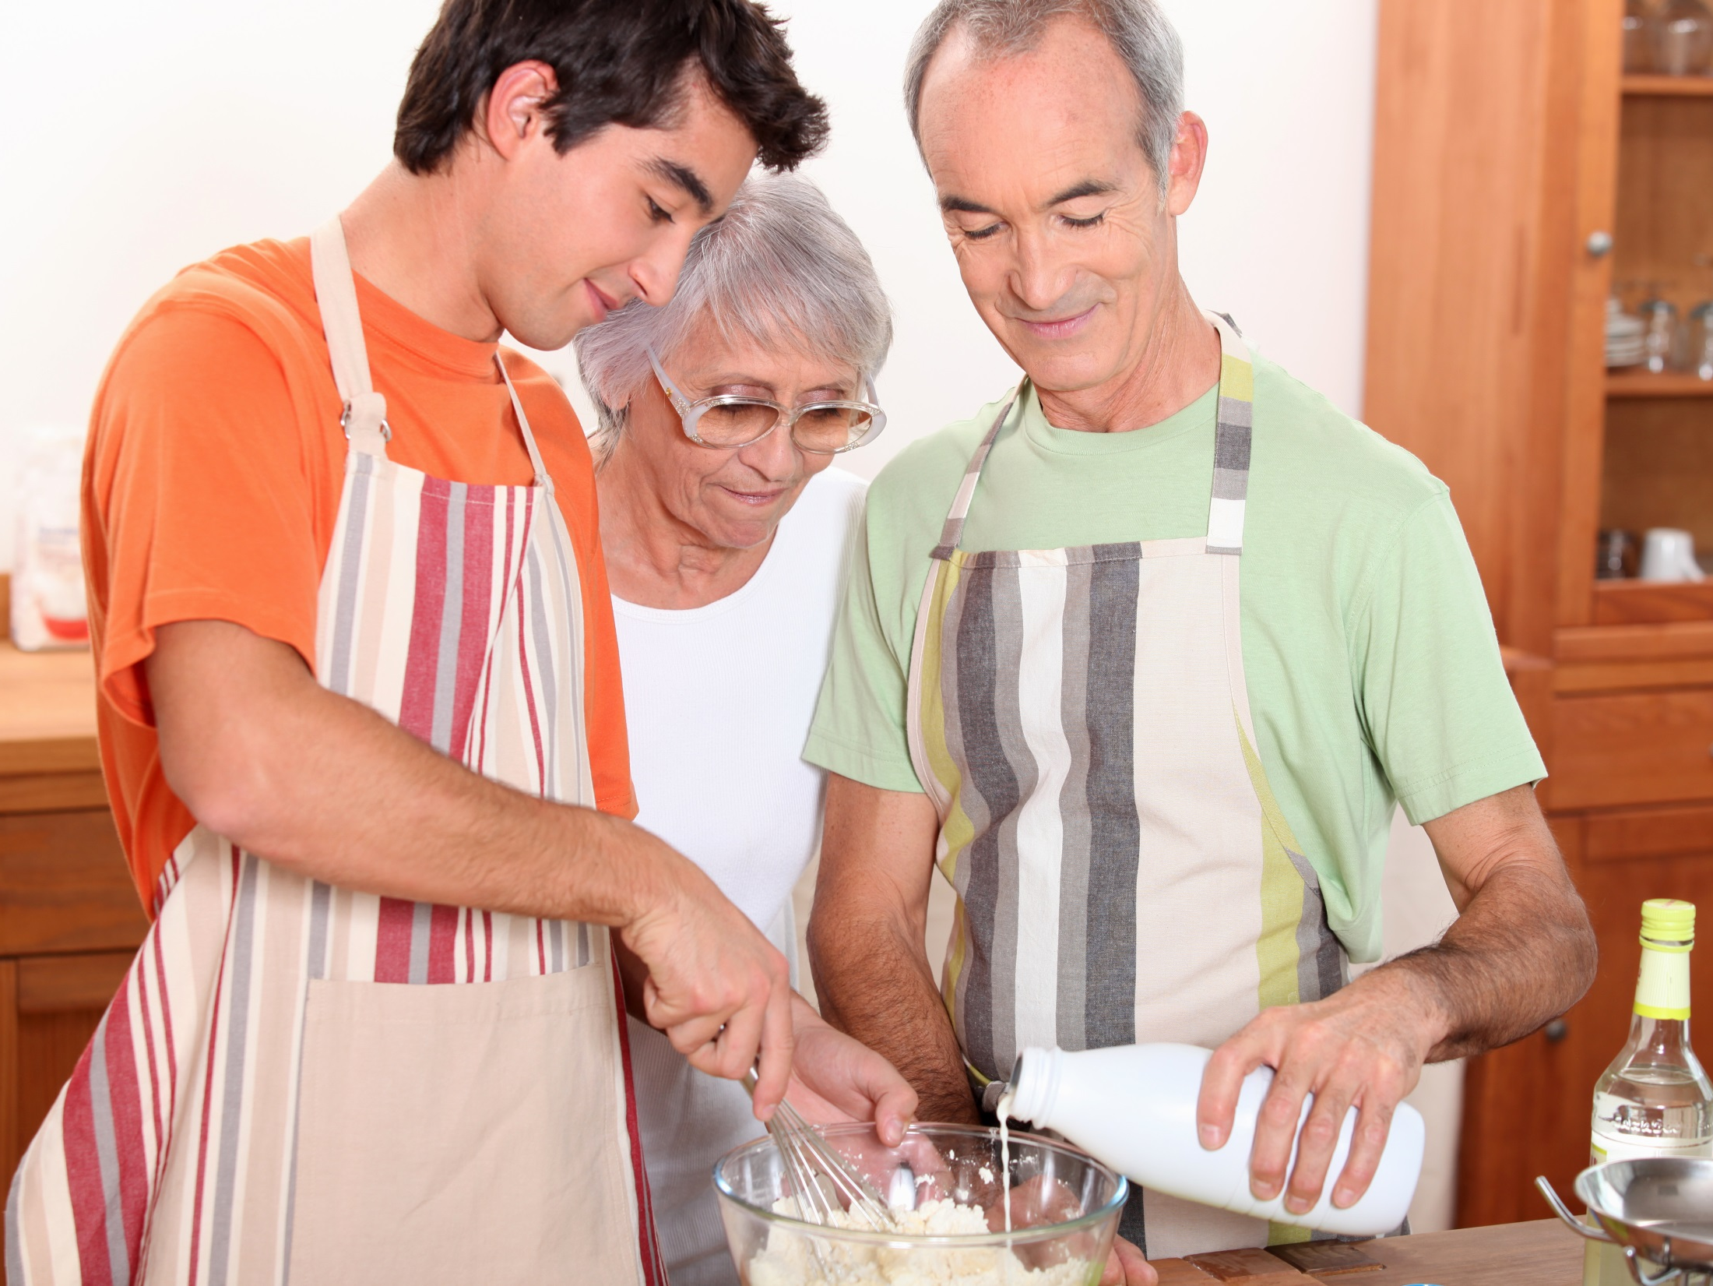

January 31, 2018

Slide 2
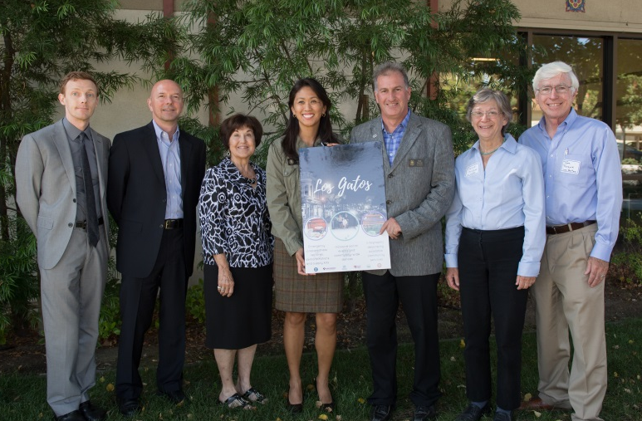
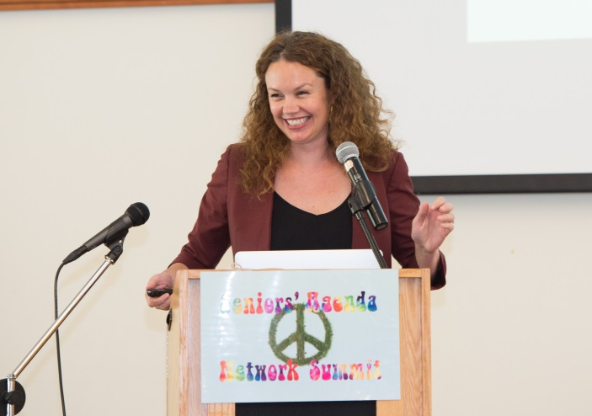
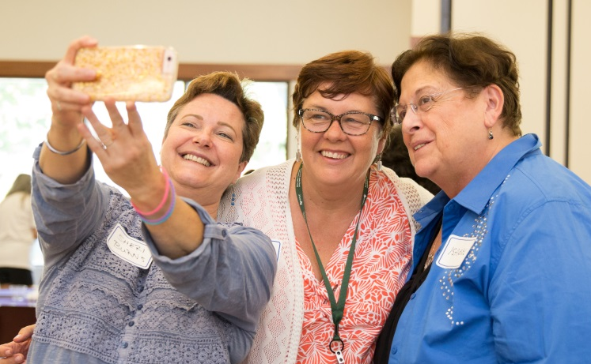
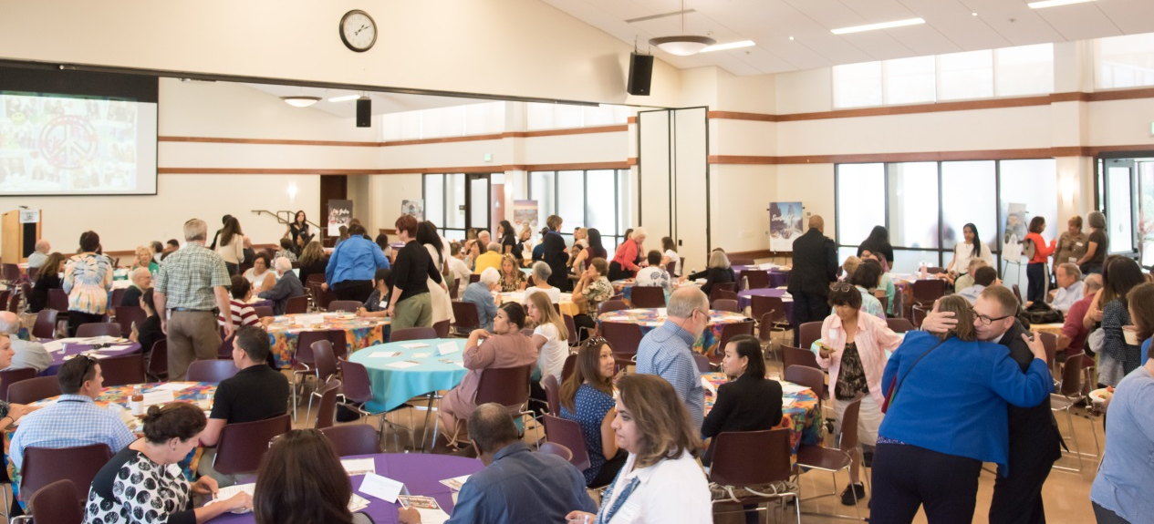
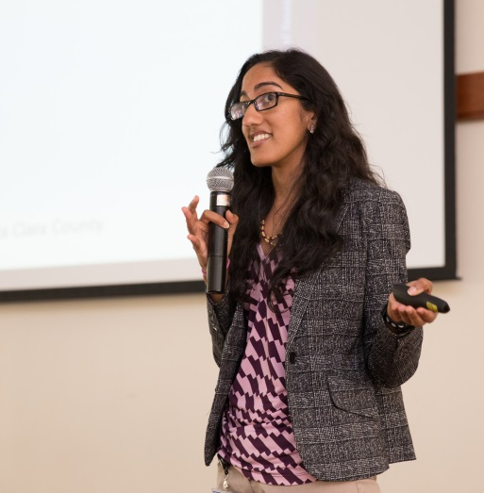
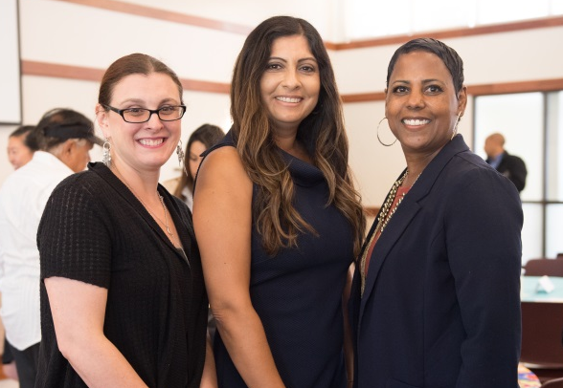
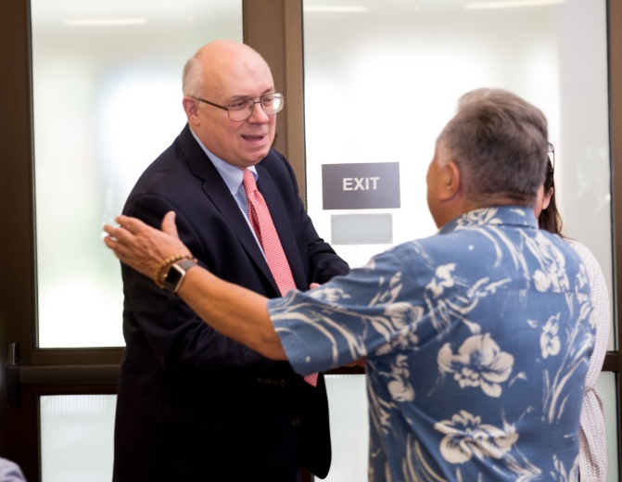
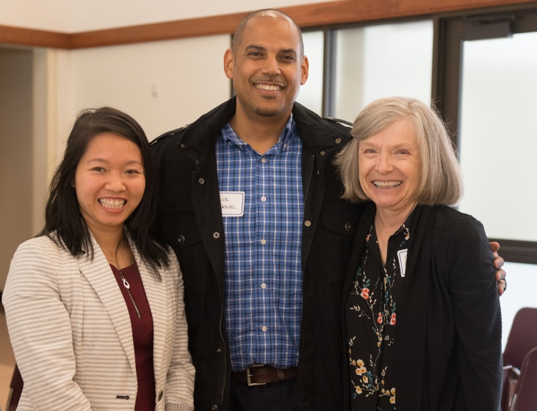
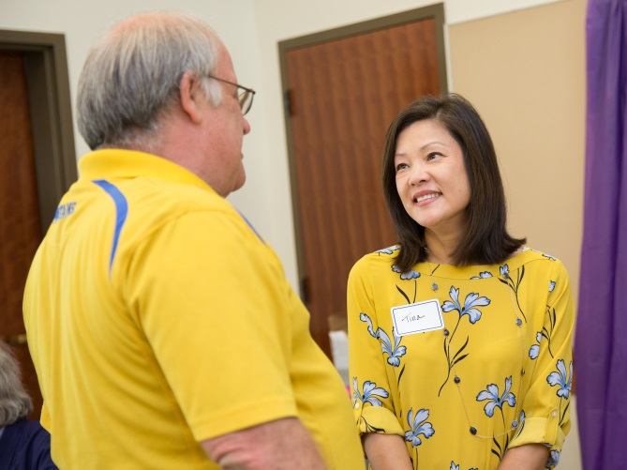

Slide 3

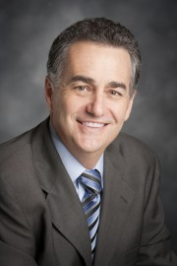

Supervisor Mike Wasserman
District 1

Slide 4


Slide 5
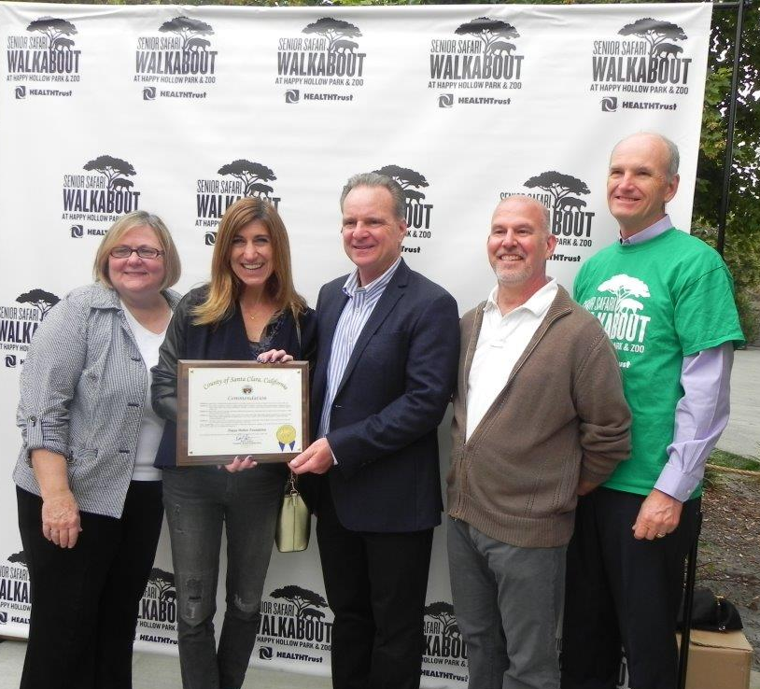
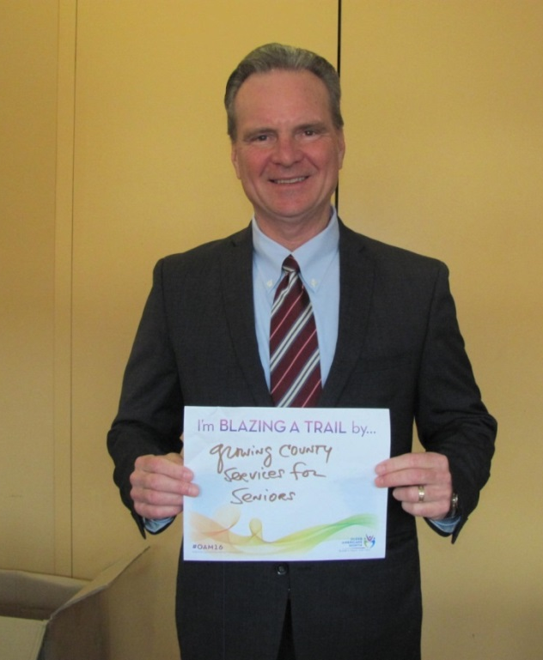
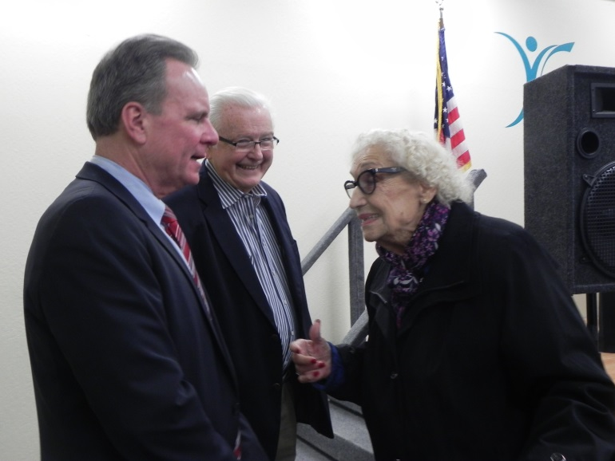

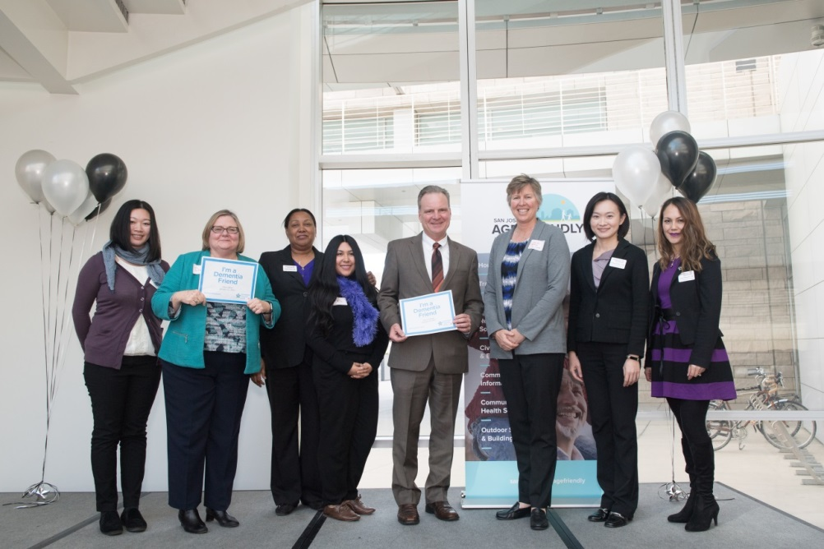
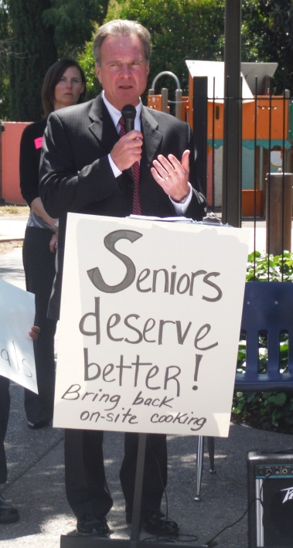
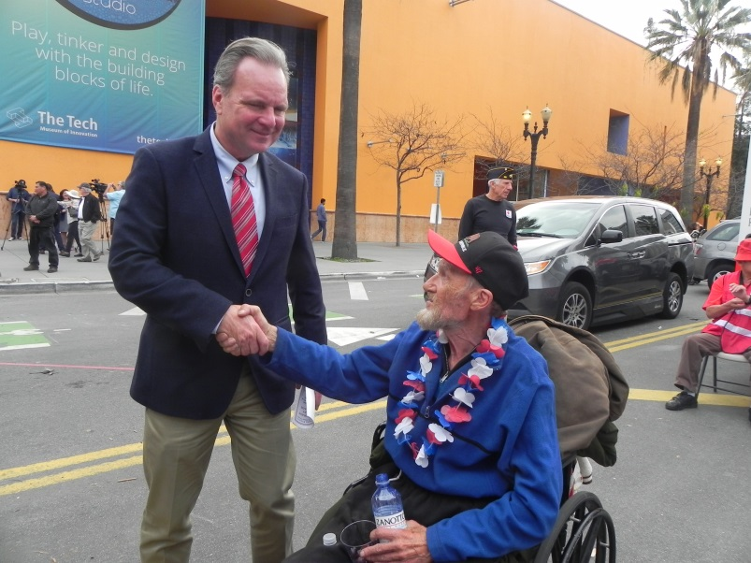

Slide 6



Slide 7



Elderly Simplified Application Project
New CalFresh Program for Adults 60 and Older
Notes:
Get from Vanessa

Slide 8
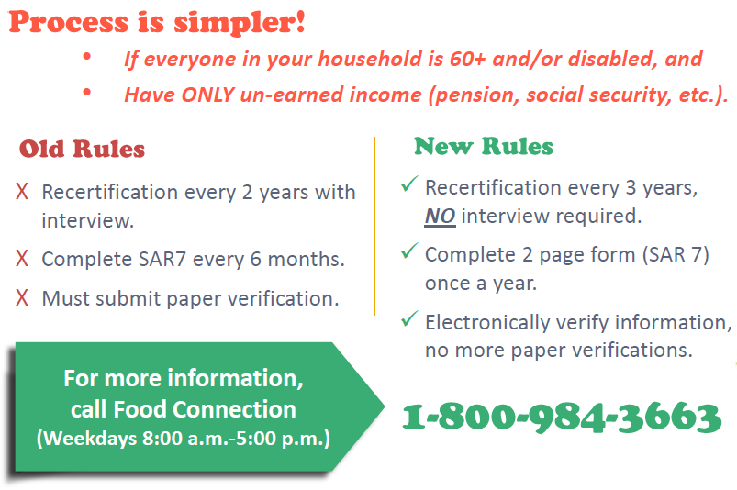

Slide 9

Notes:
Accomplishments

Slide 10
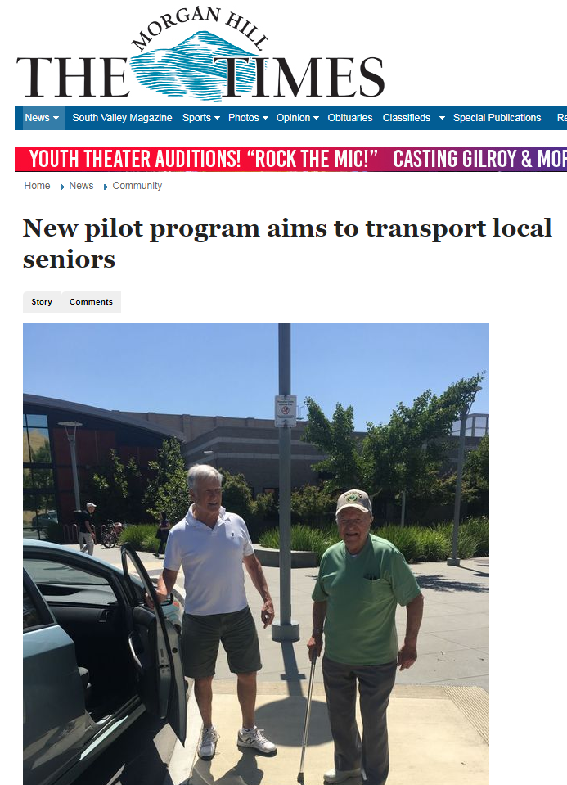
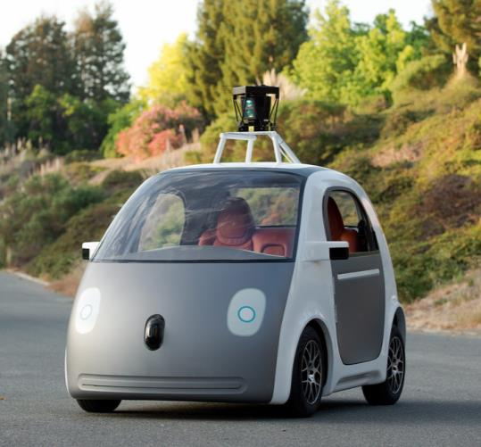
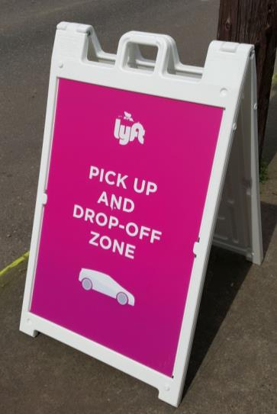

Notes:
Driverless cars, Lyft, ride programs, etc

Slide 11




Slide 12

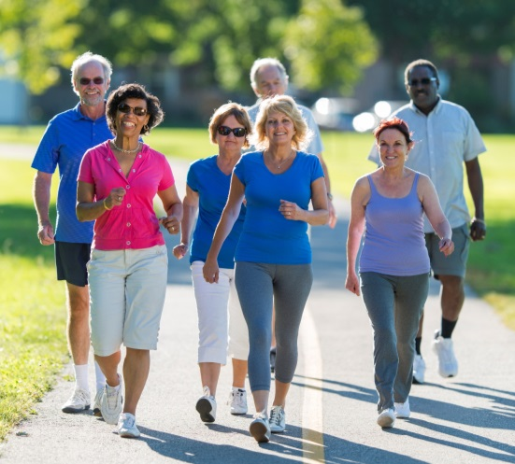

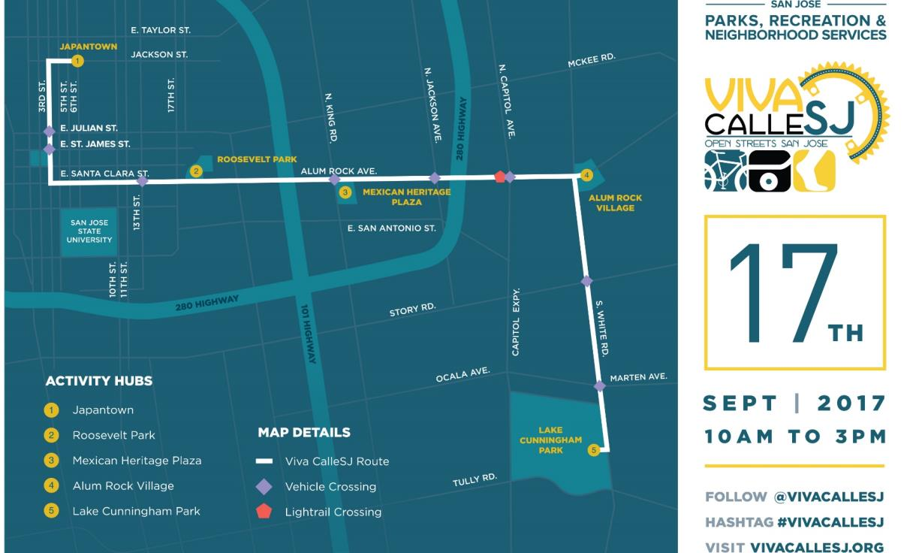
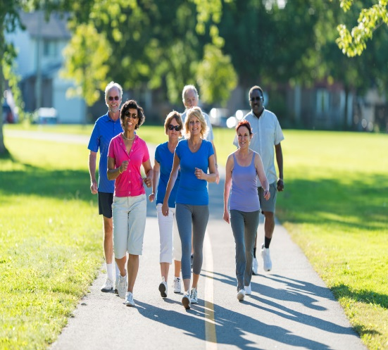

Slide 13


Slide 14
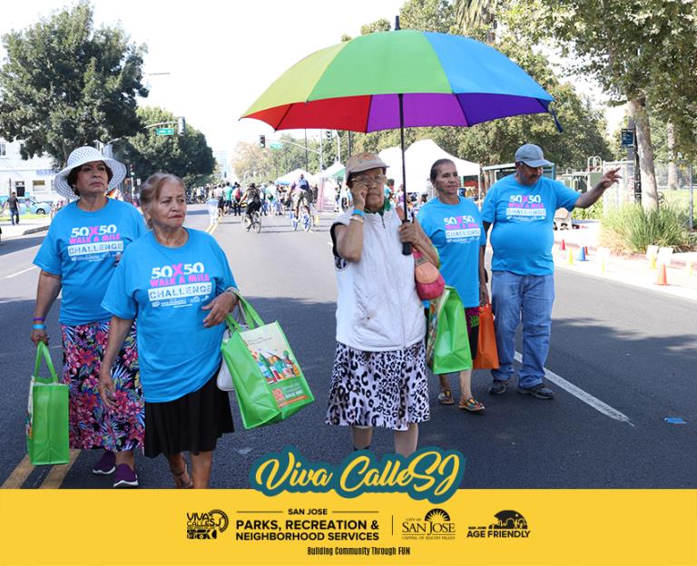
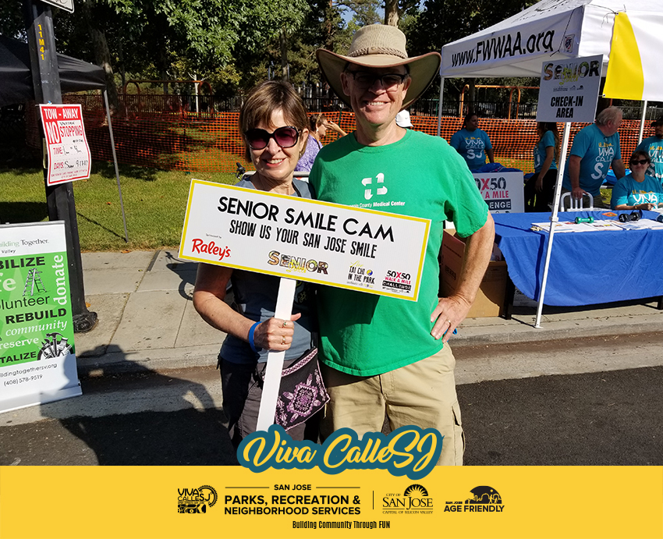
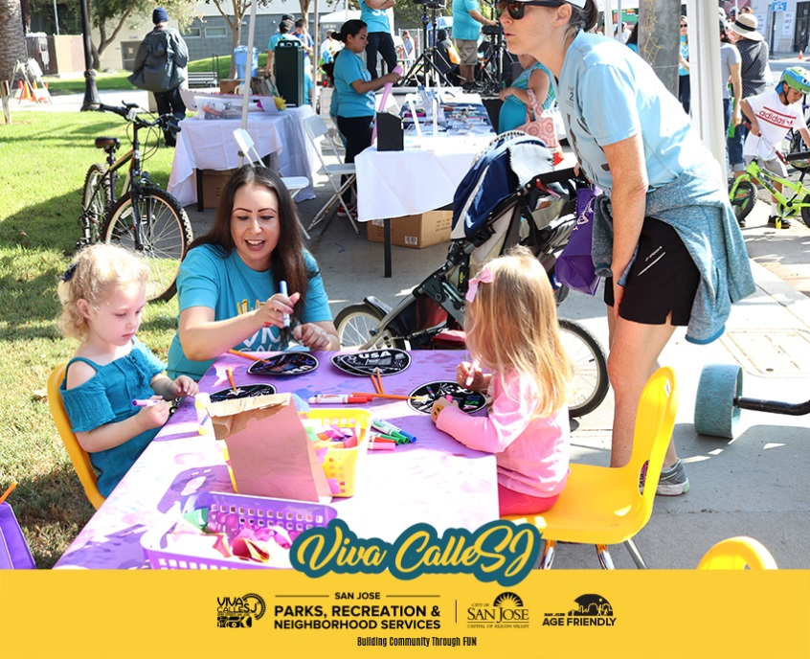
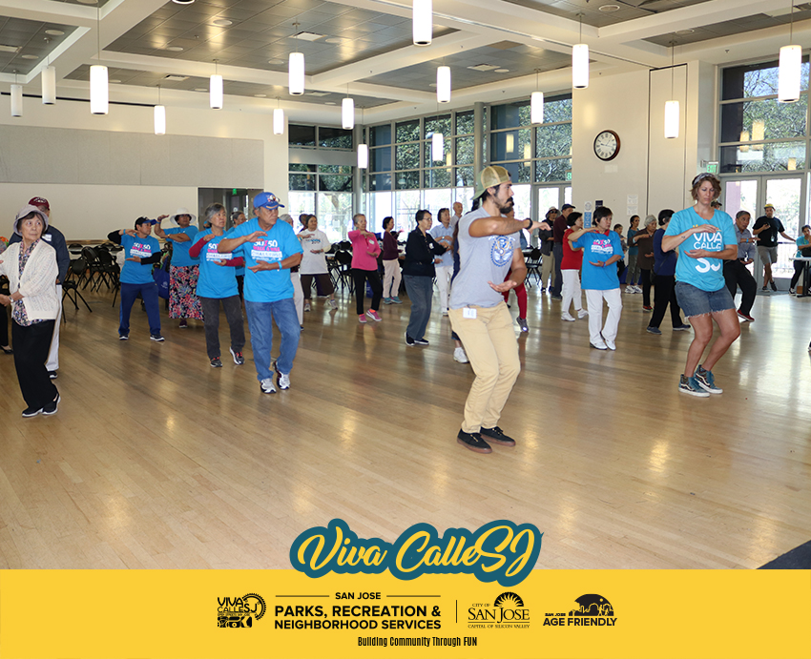
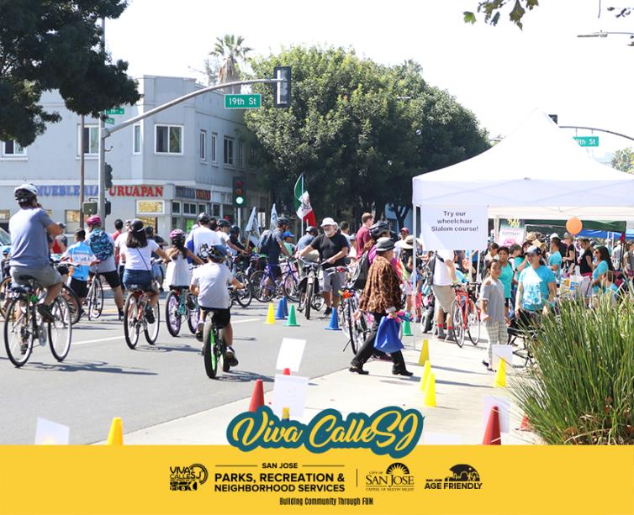
Notes:
Viva calle/intergenerational event

Slide 15

November 8, 2017
10:30 am – The Intergenerational City
Notes:
Intergenerational city November 8

Slide 16

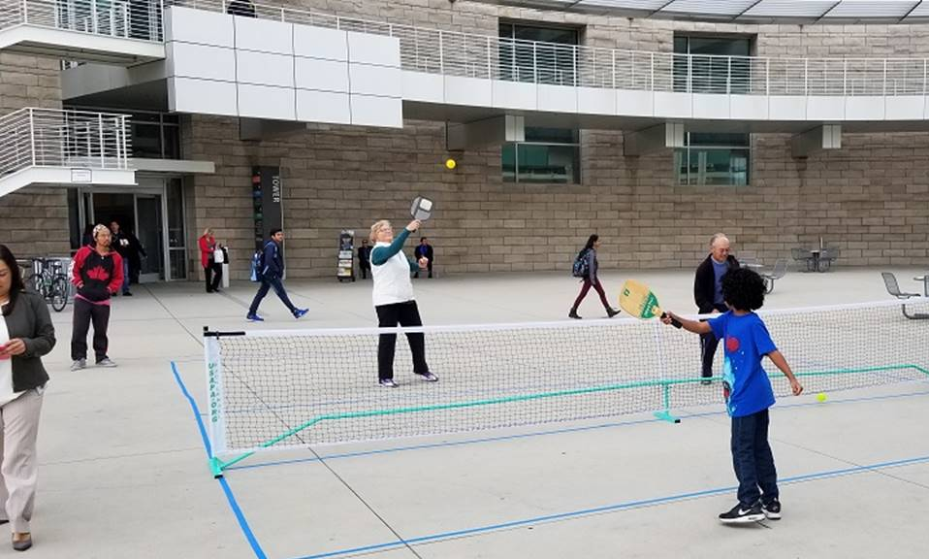
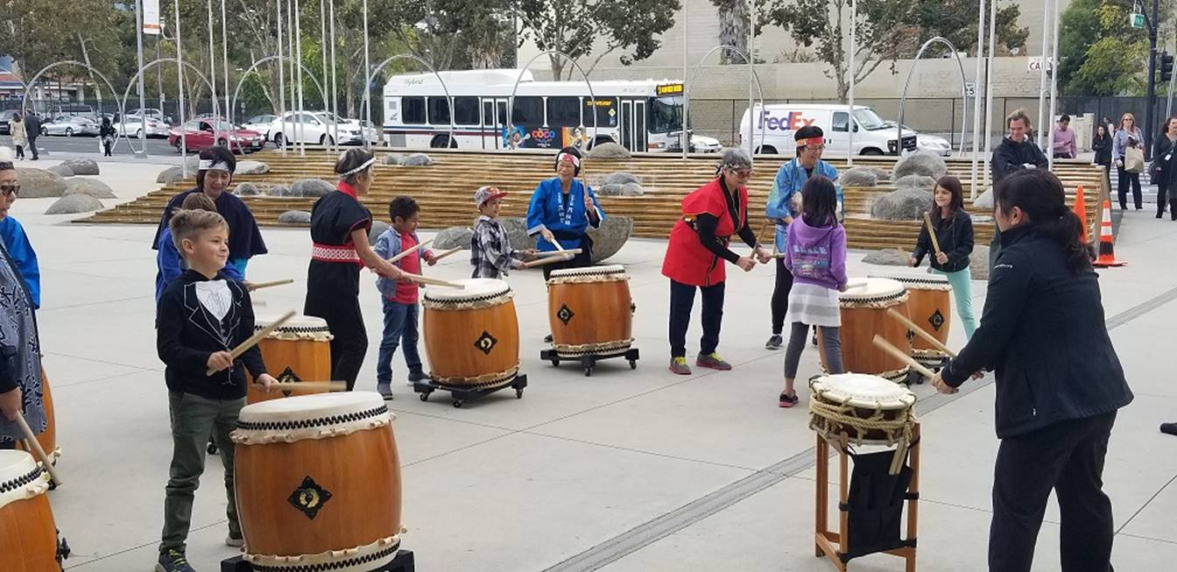
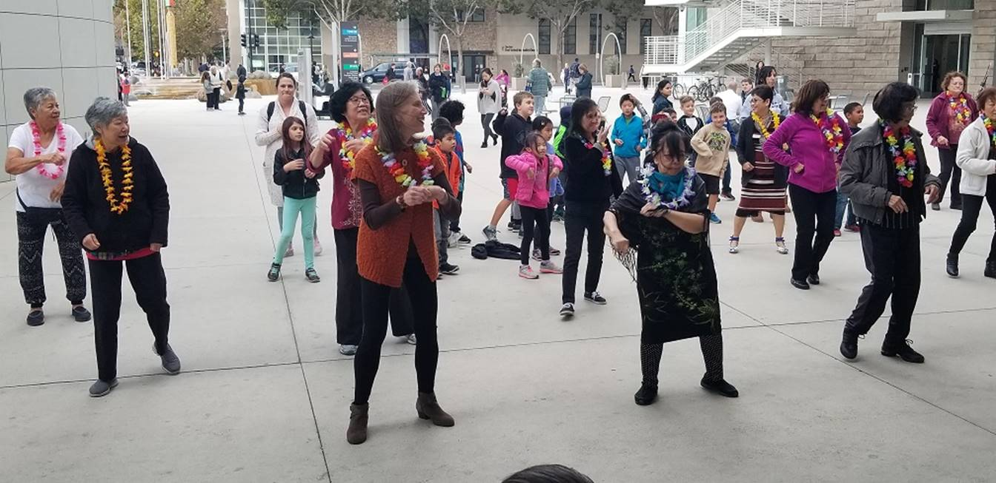
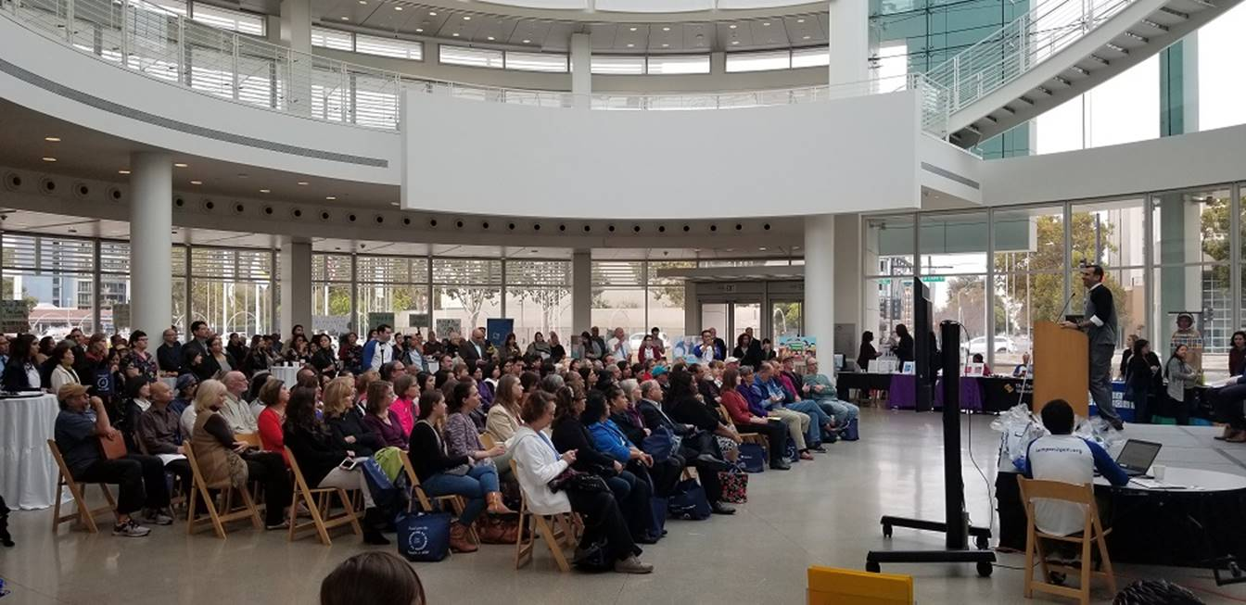
Notes:
Gil Penalosa 8-80 Project

Slide 17

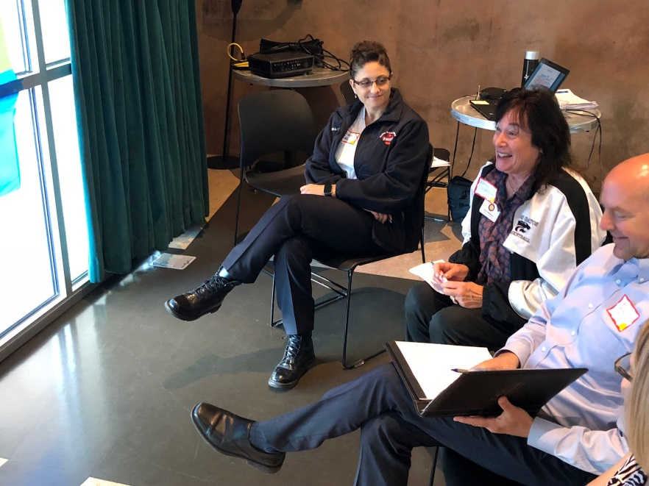
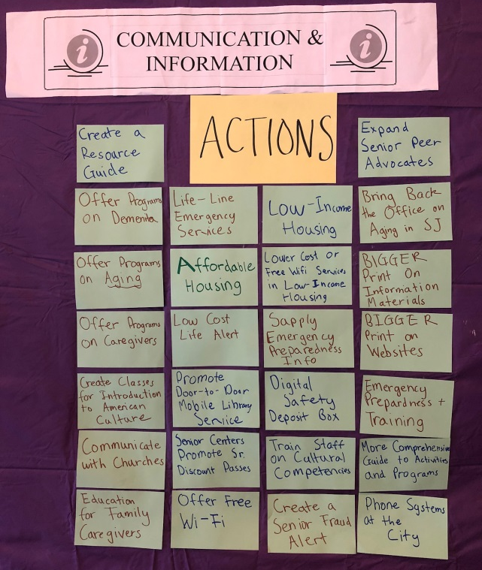
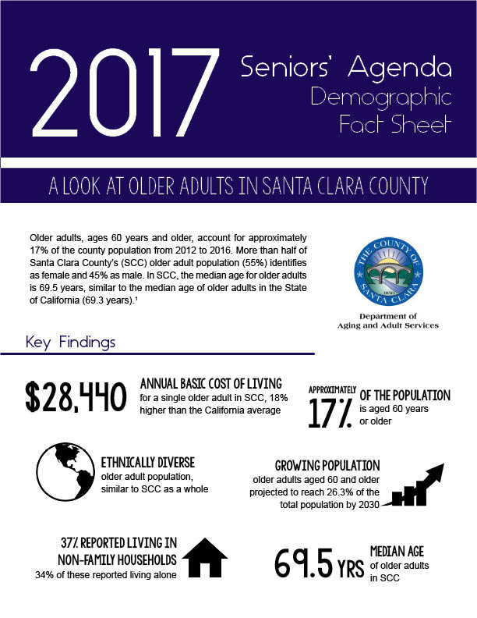
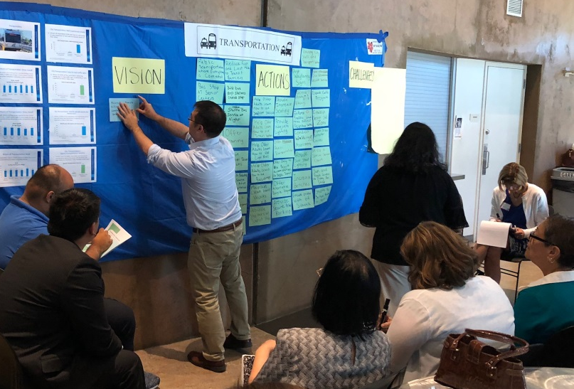
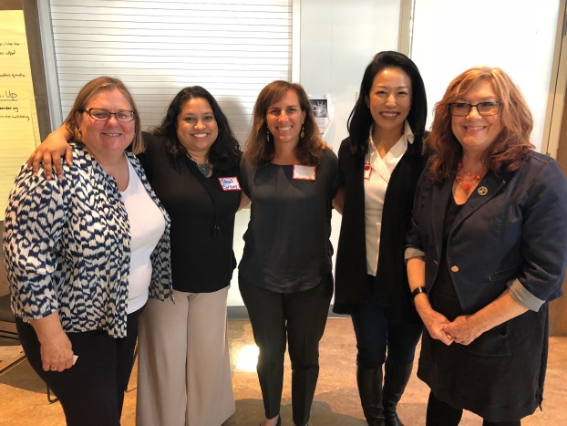

Slide 18

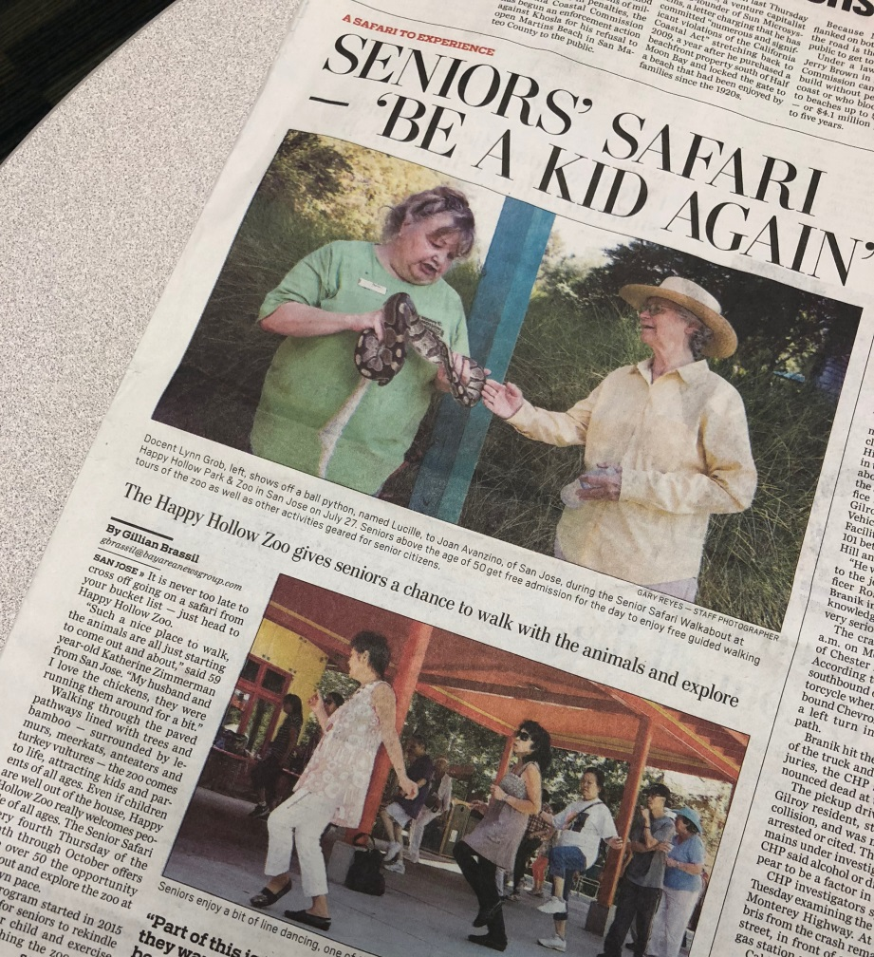
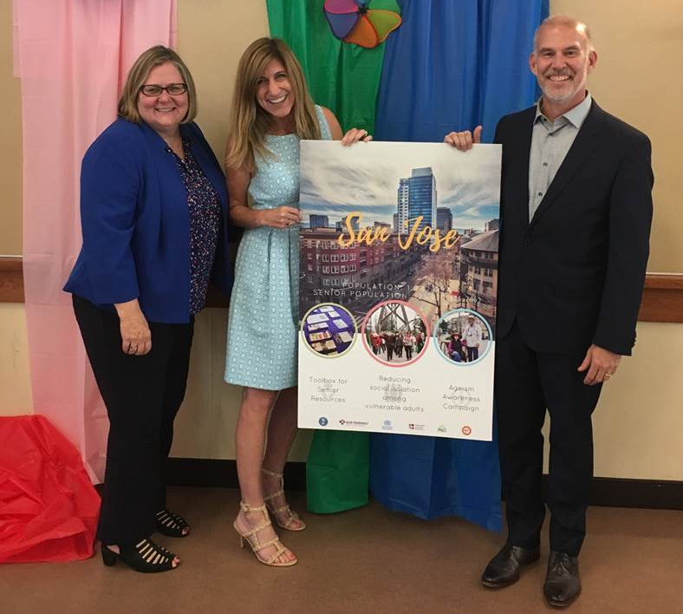
Notes:
Senior Safari (pic of Heather, Jim, & Diana?)

Slide 19






Slide 20









Slide 21
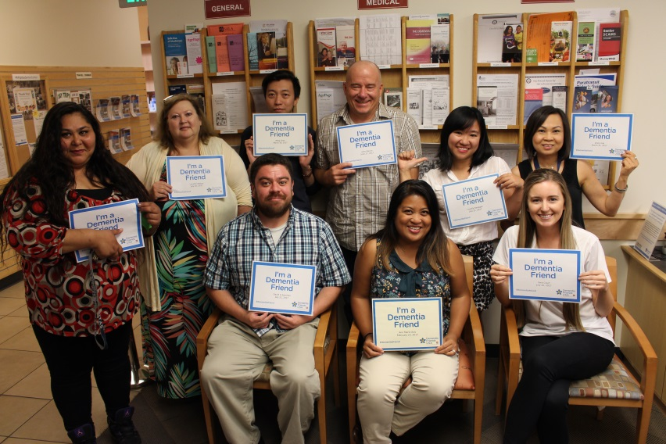
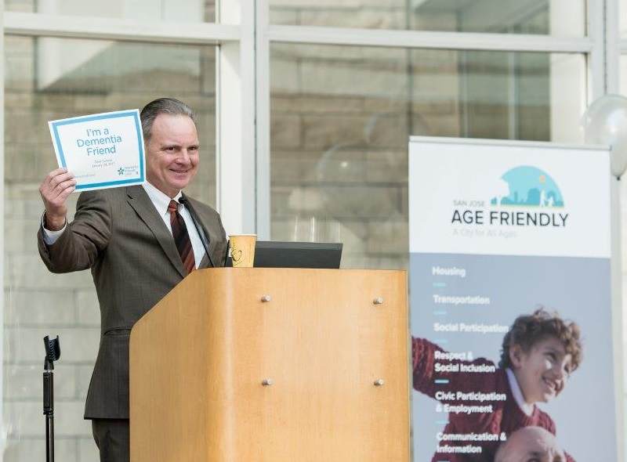

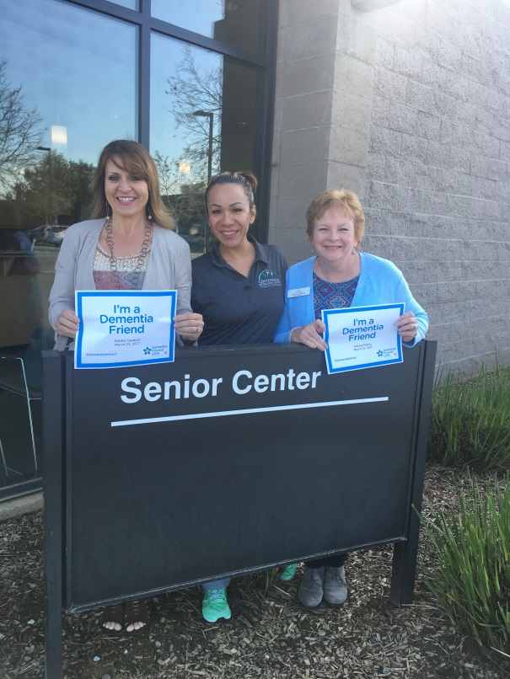
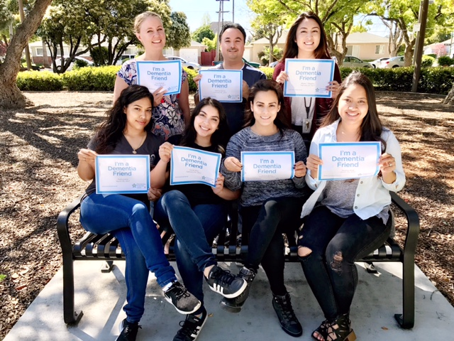
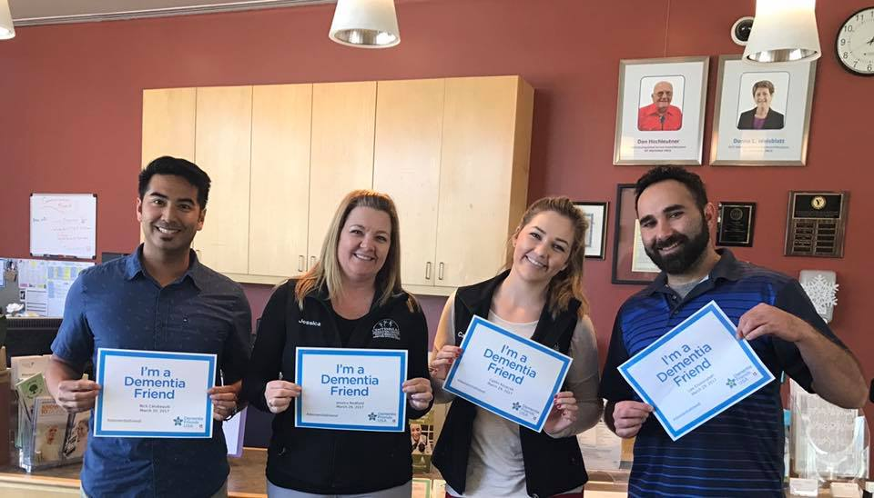

Slide 22



761 Dementia Friends in
Santa Clara County
Help us reach our goal!
Become a Dementia Friend today!
www.dementiafriendsusa.org

Slide 23
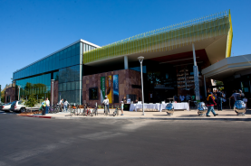
Dementia Awareness
March 28th, 7:00 to 9:00 pm
Mitchell Park Library & Community Center
3700 Middlefield Road, Palo Alto
Notes:
Mitchell Park Library & Community Center for March 28th Dementia Awareness in Palo Alto, 7-9pm

Slide 24

African American Forum
March 24th, 10:00am to 2:00 pm
Kaiser San Jose Medical Center
275 Hospital Parkway, San Jose
Notes:
https://www.alz.org/norcal/in_my_community_professionals.asp
**San Jose**
African American Forum
March 24, 2018
10 a.m. to 2 p.m.
Kaiser San Jose Medical Center
275 Hospital Parkway Bldg 6, Conf Room 1-4
San Jose, CA 95119
Topics of Discussion:
Keynote Presentation: Alzheimer’s disease: The Basics by Rochelle Woods M.D.
Other Topics:
Planning for Future Care
Ask the Expert Panel
Understanding and Responding to Dementia-Related Behaviors
In Partnership with Delta Sigma Theta San Jose Alumnae Chapter
This is a FREE event and open to the public and a complimentary lunch will be provided.
To register by phone/email or for more information, please contact Craig A. Wingate: 408.372.9933 or email cwingate@alz.org

Slide 25

YOUNG & OLD TOGETHER:
Innovations in Intergenerational Programs and Policies
DONNA BUTTS
Executive Director
Notes:
Keynote Title

Slide 26
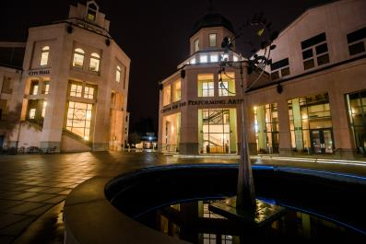
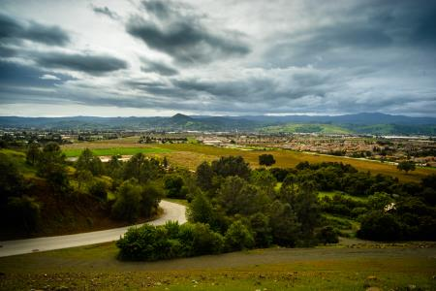
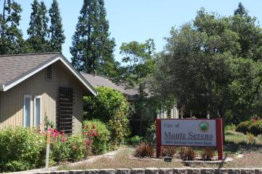
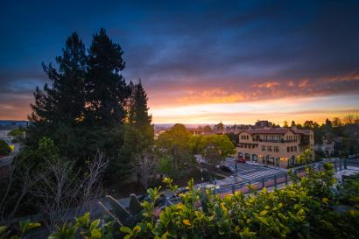













Slide 27




Slide 28







Slide 29





Using Technology, Innovations and Data to Create a New Future for Caregiving
Thursday, March 8
6:30 p.m.
Rajiv Mehta
Mark Lukach
Gary Wolf
Dawn Nafus

Slide 30



CAREMAPPING WORKSHOPS

Slide 31
Expert Roundtable 2014
Pilot Study 2015-2016

Slide 32

Notes:
Opportunities

Slide 33


Saturday, May 19, 2018
8:30 am to 2:00 pm
Campbell Community Center
1 West Campbell Avenue
Notes:
Caregivers count 5/19 event

Slide 34

5th Annual Alzheimer’s
Latino Caregiver Conference
12th Annual Chinese
Alzheimer’s Forum
(Presented in Spanish)
(Presented in Mandarin)
Sunday, April 22, 2018
8:00 am to 2:00 pm
(8:00 to 9:00 am Health Screening)
Mexican Heritage Plaza
1700 Alum Rock Ave, San Jose
Saturday, May 19, 2018
2:00 to 5:00 pm
Intel Auditorium
3600 Juliette Lane, Santa Clara

Slide 35


STOP SENIOR BULLYING
Thursday, March 15
10:00am to 12:00pm
SSA Auditorium
333 West Julian St. San Jose

Slide 36


Friday, March 16, 12:00 to 3:30 pm
El Camino Hospital, Mountain View
RSVP on Eventbrite

Slide 37

REIMAGINING THE WORKFORCE OF THE FUTURE:
multigenerational, dynamic, resurgent
PayPal Town Hall
2161 N. First St. San Jose
Building 12
Tuesday, February 13
5:00 to 7:30 pm
Register online: www.thesvo.com

Slide 38


FY19 Community Benefit
Online Grant Program Application
Funding Priorities:
Healthy Body
Healthy Mind
Healthy Community
Application deadline:
February 22, 2018, 5:00 pm

Slide 39


ENGAGING ACADEMICS AND
POLICY MAKERS FOR OLDER ADULTS
Presented by SJSU CHAMP
FRIDAY, MAY 4, 2018
Notes:
5/4 SJSU CHAMP/Policymaker event

Slide 40


Slide 41

https://www.surveymonkey.com/r/Jan18Summit

Slide 42

Notes:
Next summit 8/29

Slide 43

Notes:
Thanks for coming

Slide 44
https://www.surveymonkey.com/r/Jan18Summit

